Slide 1
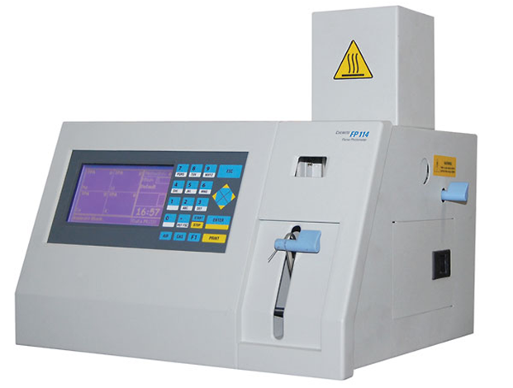
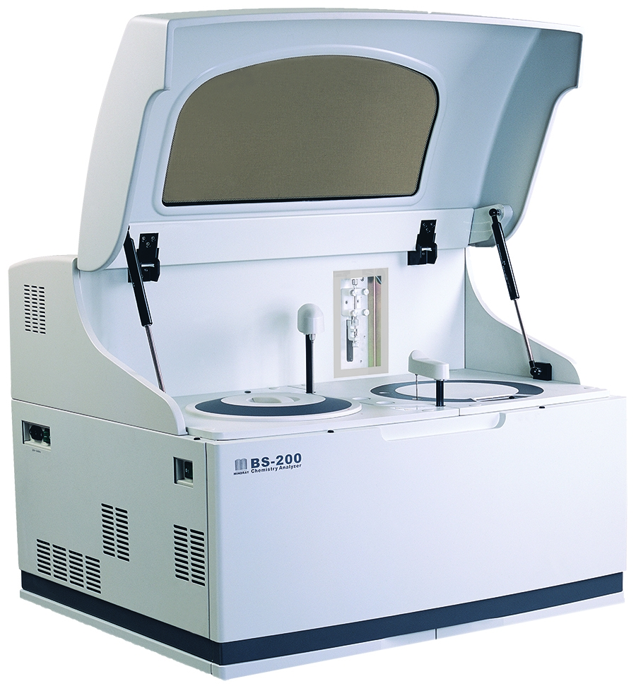
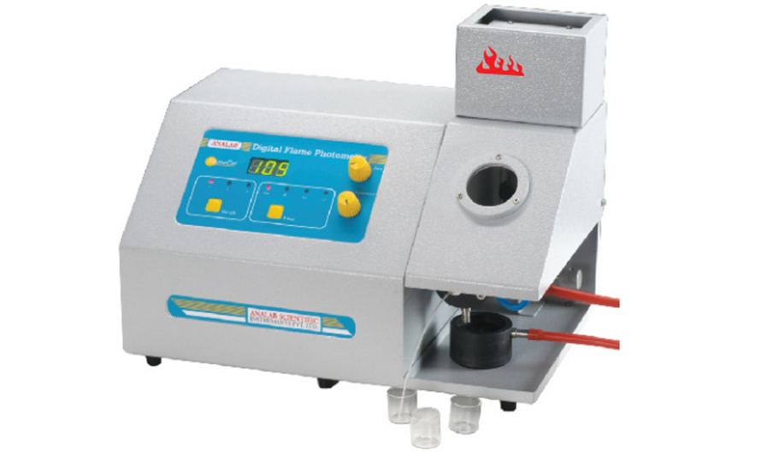
Bio-Chemistry equipment
18.7.8 Maintain a blood gas analyser
principles of operation
construction
troubleshooting
preventive maintenance theory
safety considerations
performance monitoring
18.7.7 Maintain a flame photometer
18.7.6 Maintain a chemistry and immunochemistry analyser
18.7.4 Maintain a hemoglobin and glucose meter
Unit C18.7 Maintaining Laboratory Equipment
Module 279 19 C Medical Instrumentation II
©
dr. Chris R. Mol, BME, NORTEC, 2016

Slide 2
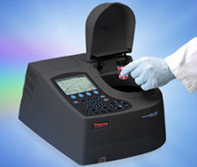

Spectrophotometry
Spectrophotometry is a method to measure the absorption of light by a chemical substance: this absorption is linear dependent on the concentration of the sample (Beer-Lambert Law).
In this technique, a single color (mono-chromatic) beam of light shines through a solution with a sample of the substance to be analysed. The amount of light that passes through the sample is measured. From this, the amount of substance in the sample is calculated.
A spectrometer needs to be able to produce a variety of wavelengths (from IR to UV) because different compounds absorb best at different wavelengths. The actual wavelength used for a certain measurement therefore depends on which analysis is to be done.
spectrophotometer
The different wavelengths (colours) that pass through a sample indicate what substances are in the sample.
Spectrophotometry is the basis for many of the instruments used in the biochemistry lab.
©
Bio-Chemistry equipment
dr. Chris R. Mol, BME, NORTEC, 2016

Slide 3
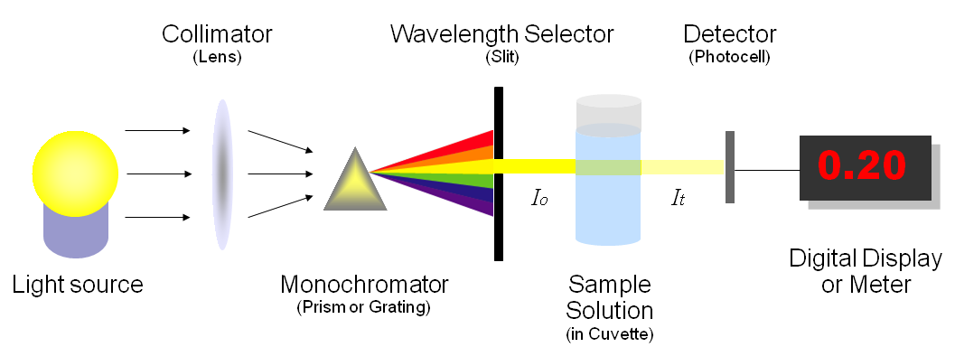
Spectrophotometry principle
The spectrometer produces the desired range of wavelength of light. First a collimator (lens) transmits a straight beam of light that passes through a monochromator (prism) to split it into several component wavelengths (spectrum). Then a wavelength selector (slit) transmits only the desired wavelengths.
The photometer detects the amount of photons that have passed through the sample in the cuvette. It sends the resulting signal to (a galvanometer or) a digital display.
©
Bio-Chemistry equipment
dr. Chris R. Mol, BME, NORTEC, 2016

Slide 4
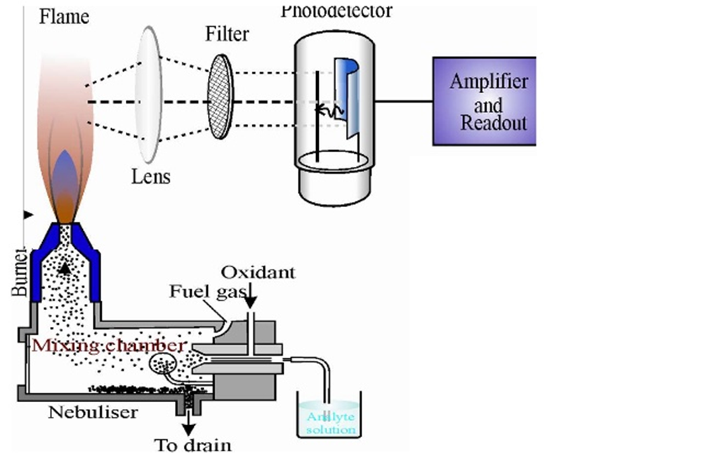
Flame photometry
monochromator
Flame photometry is used to determine the concentration of certain metal ions such as sodium, potassium, lithium, calcium etc.
In this technique, the fluid sample is nebulized and mixed with gas to be burnt in a flame. The light of the flame is led to a photodetector that determines the intensity of the light at certain frequencies (depending on the element to be measured).
schematic representation of the flame photometer
©
Bio-Chemistry equipment
dr. Chris R. Mol, BME, NORTEC, 2016

Slide 5
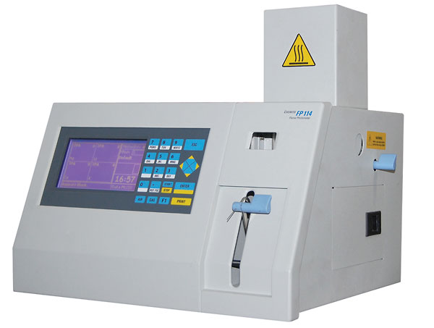
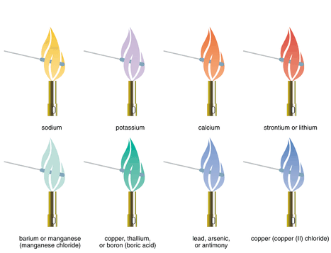
Flame photometry
Flame photometry is related to spectrophotometry but has some different characteristics:
  it looks at ‘emission’ of light, rather than ‘transmission’ of light.
  the sample is mixed in the flame
  only a few elements can be analyzed (pure metals)
flame photometer
different elements emit different colors
©
Bio-Chemistry equipment
dr. Chris R. Mol, BME, NORTEC, 2016

Slide 6
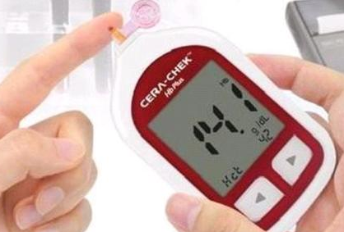
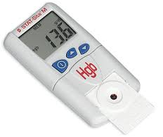
Hemoglobin meter
A hemoglobin meter is a type of spectrophotometer: a color measuring device. It is used to determine hemoglobin concentrations in the blood. This is a critical measure for ‘iron deficiency anemia’ which is the most prevalent nutritional disorder in the world.
The haemoglobinometer is a portable, battery operated, manually operated colorimeter designed to provide direct, accurate haemoglobin concentration readings.
Some require dilution of blood before haemoglobin measurement.
hemoglobinometers
©
Bio-Chemistry equipment
dr. Chris R. Mol, BME, NORTEC, 2016

Slide 7
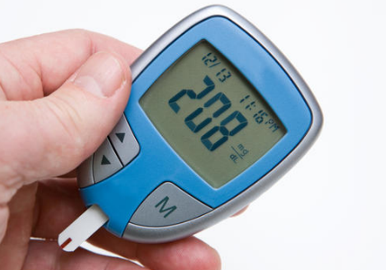
Glucometer
A glucose meter (or glucometer) is used to determine the concentration of glucose in the blood, important for patients with diabetes. A small drop of blood is placed on a disposable test strip that the meter reads and uses to calculate the blood glucose level. The meter then displays the level in units of mg/dl or mmol/l.
Most glucometers today use an electrochemical method, where the glucose in the blood reacts with chemicals on the test strip. The electrical properties of the resulting material are related to the amount of glucose in the blood and are measured. From this, the glucose concentration is calculated and displayed.
glucometer
The times it takes to read a test strip may range from 3 to 60 seconds for different models.
©
Bio-Chemistry equipment
dr. Chris R. Mol, BME, NORTEC, 2016

Slide 8
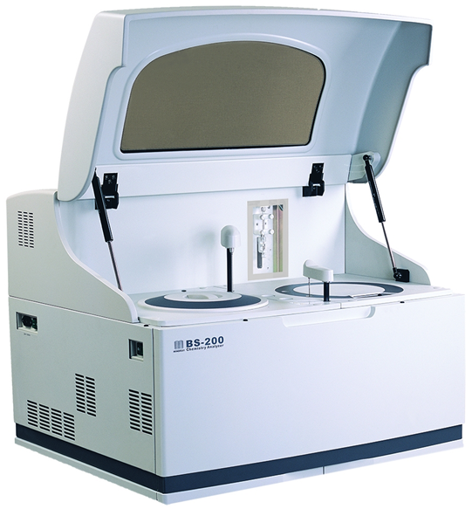
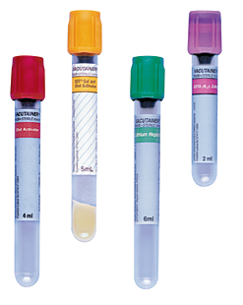
Automated Analysers
An automated analyser is designed to measure different chemicals and other characteristics in biological samples quickly, with minimal human assistance. Operator involvement is restricted to introducing samples into the analyser and evaluation the results of the analysis.
Different analysers have different ways to introduce a sample into the analyser:
  placing test tubes of sample into racks, which can be moved along a track,
  inserting tubes into circular carousels that rotate to make the sample available.
  some analysers require samples to be transferred to sample cups.
More recently, to protect the safety of laboratory staff, analysers feature closed tube sampling, preventing workers from direct exposure to samples.
tubes for closed tube sampling: the fluid can only leave the tube inside the analyser.
Usually, the different types of automated analysers in the hospitals are (and should be) covered by a maintenance contract. Like imaging equipment, these devices are too complex for corrective maintenance by unspecialized BMETs.
©
Bio-Chemistry equipment
dr. Chris R. Mol, BME, NORTEC, 2016

Slide 9
Chemistry analysers
Chemistry analysers measure the concentration of analytes in blood or other bodily fluids based on specific chemical reactions by photometry. Applications include normal clinical diagnosis but also drug abuse monitoring etc.
Chemistry analysers comprise among others:
  dry chemistry analysers using sample-impregnated dipsticks onto which chemical reactions are detected,
  wet chemistry analysers testing analytes in solution.
Various models of chemistry analysers are available, some measure a single analyte, e.g. glucometers, haemoglobinometers; others measure more than ten.
Chemistry analysers are available as bench top instruments with various degrees of automation or in portable formats. Chemistry analysers group a large family of instruments including various photometers and colorimeters.
dry portable chemistry analyzer
wet chemistry analyzer
©
Bio-Chemistry equipment
dr. Chris R. Mol, BME, NORTEC, 2016

Slide 10
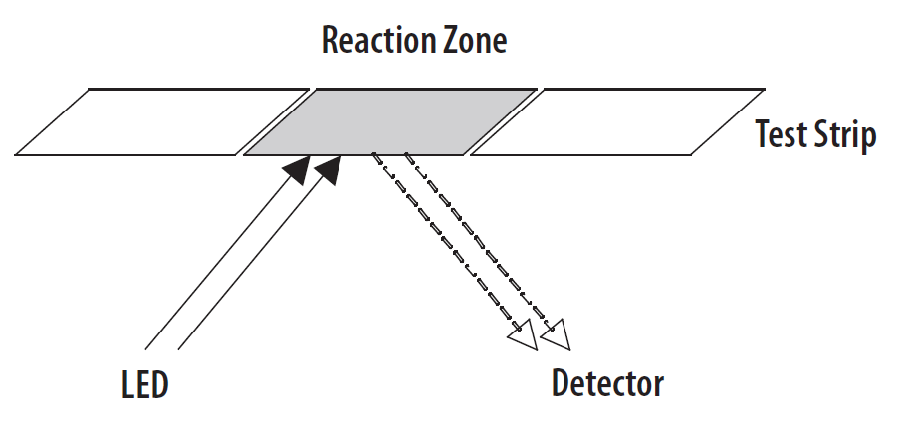
Dry chemistry analyser
A dry chemistry analyser is a reflectance photometer, measuring how much light reflects from a sample.
Reflectance photometry quantifies the intensity of a chemical reaction generating colour on a surface (e.g., slide, test strip).
Light is emitted at a specific wavelength onto the test strip by the instrument’s light source (e.g. LED). The coloured product absorbs that wavelength of light. The more analyte in the sample, the more product (colour) and the less the light is reflected.
The instrument’s detector measures the reflectance and converts it into an electronic signal. This signal is translated into the corresponding concentration of analyte in the bodily fluid tested and the concentration is then printed and/or shown on a LED digital display.
©
Bio-Chemistry equipment
dr. Chris R. Mol, BME, NORTEC, 2016

Slide 11
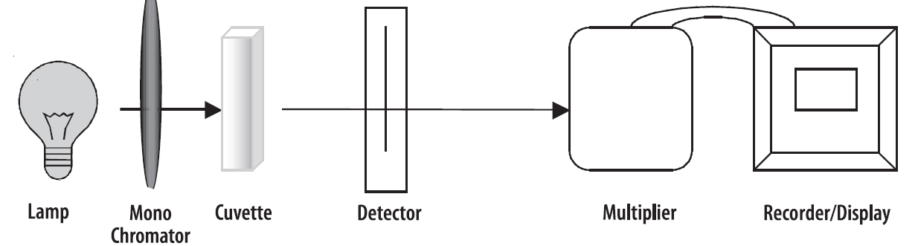
Wet chemistry analyser
The wet chemistry analyser is a photometer.
One of several or a single colour filter is used to measure the absorption of light in liquid samples according to the Beer-Lambert law. The wet chemistry analyser generally uses a light source such as a halogen lamp with filters. More recent models use a single LED or several LEDs at specific wavelengths. Tests performed on wet chemistry analysers are based on the production of a coloured compound of the analyte with specific reacting reagents. The colour is directly proportional to the concentration of analyte(s) in solution. Typically, measurements are performed between 304 and 670 nm or with additional filters.
Only staff trained and authorized to use the wet chemistry
analyser are allowed to operate the instrument.
Basic components of a photometer
©
Bio-Chemistry equipment
dr. Chris R. Mol, BME, NORTEC, 2016

Slide 12
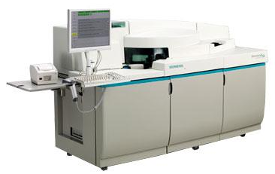
Immuno chemistry analyser
Immunochemistry involves the study of the molecular mechanisms underlying the function of the immune system, especially the nature of antibodies, antigens and their interactions.
Immunochemistry analyzers automatically run tests on samples from patients to detect any number of biologically active substances, such as hormones and vitamins, testing for e.g. cancer, hepatitis, fertility problems, etc.
Immuno chemistry analysers are special, because they test for substances with a 1000 - 1,000,000 times lower concentration than chemistry analysers.
There are many varieties of immunochemistry analyzers available, including several benchtop models. Prices for purchase are from 18,000 USD to 100,000+ USD.
©
Bio-Chemistry equipment
dr. Chris R. Mol, BME, NORTEC, 2016

Slide 13
Maintenance of chemistry analysers
Chemistry analysers require minimal maintenance and automatically perform self-calibration routines. The guidelines below are general procedures applicable to most instruments. Always carefully follow the manufacturer’s instructions for calibration, regular servicing and maintenance of an analyser.
Frequency: Daily (user)
1. Any spill on, or around the instrument should be cleaned immediately.
2. At the end of the day, disconnect the power source by switching off at the wall socket if applicable and removing the plug or disconnecting the battery terminals.
3. For dry chemistry analysers: do not leave test strips in the instrument. Regularly clean the window or compartment where test strips are inserted and keep it closed. Use a soft, clean damp swab.
4. For wet chemistry analysers: Keep the sample chamber empty and closed when not in use.
5. Cover the instrument after use.
6. Store appropriately away from dust.
this and next slides are here to demonstrate that general knowledge of equipment maintenance plus and understanding of the nature of a device are a very large part of being able to do competent equipment maintenance.
©
Bio-Chemistry equipment
dr. Chris R. Mol, BME, NORTEC, 2016

Slide 14
Maintenance of chemistry analysers
Frequency: Monthly (user)
The window and/or front surface of the photodetector should be inspected and cleaned with lens tissue.
Frequency: Every six months (user or BMET)
Inspect the instrument visually to verify the integrity of its components.
Verify that the buttons or control switches and mechanical closures are mounted firmly and that their labels are clear.
3. Ensure that all the accessories are clean and intact.
4. Check the adjustment and condition of nuts, bolts and screws.
5. Make sure the electrical connections do not have cracks or ruptures. Test that they are joined correctly.
6. If applicable:
    a. Verify that cables securing devices and terminals are free from dust, grime or corrosion.
    b. Verify that cables are not showing signs of splicing or of being worn out.
    c. Examine that the grounding system (internal and external) is meeting the electric code requirements.
7. Make sure the circuit switches, fuse box and indicators are free from dust, corrosion and grime.
8. Check lamp alignment if recommended by the manufacturer.
©
Bio-Chemistry equipment
dr. Chris R. Mol, BME, NORTEC, 2016

Slide 15
Maintenance of chemistry analysers
Frequency: Annually (BMET)
These tests must be performed by an electrician (for instruments using main power), engineer or other trained
personnel. Results must be recorded and retained for follow up through time.
1. Check the installation location for safety of the electrical and the physical infrastructures.
2. Check that the mains power voltage does not vary more than 5% from the voltage in the equipment specification
3. Check that there is sufficient space around the instrument for the connecting cables and for adequate ventilation.
4. Test the integrity of the counter and its cleanliness.
5. Verify that the instrument is away from equipment generating vibrations and direct solar radiation.
6. Check that there is no excessive humidity, high temperature or dust.
7. Ensure that there is no source of smoke, gas or corrosive emissions nearby.
©
Bio-Chemistry equipment
dr. Chris R. Mol, BME, NORTEC, 2016

Slide 16
Corrective Maintenance of chemistry analysers
These instructions are general guidelines for troubleshooting chemistry analysers. Since there are numerous models available, always refer to the instruction manual from the manufacturer and follow the steps recommended.
1. If there is no light passing through the system, or if its intensity is not constant, change the bulb.
2. If there is light in the system but no display response, change the photocell.
3. Always replace blown fuses and bulbs according to the manufacturer’s instructions.
4. If the chemistry analyser fails to switch on, check the electric socket outlet. Plug and check the fuse or the battery terminals.
6. In case of a major breakdown, consult a qualified biomedical engineer.
©
Bio-Chemistry equipment
dr. Chris R. Mol, BME, NORTEC, 2016

Slide 17
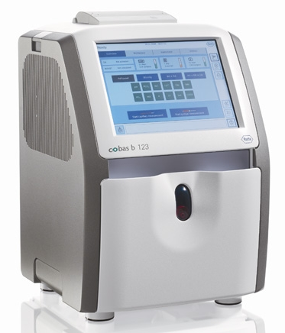
Blood gas/pH analyzers
Blood gas/pH analyzers measure pH, PO2, and PCO2, from an arterial blood sample. (not from finger tip!). This test is also know as the arterial blood gas (ABG) test
The pH (acidity) of plasma reflects its concentration of hydrogen ions (H+) and has a normal range of 7.35 to 7.45
Values for PO2 and PCO2 reflect the concentrations (gas pressures) of these gases in arterial blood.
  the normal arterial PO2 value is between 80 and 100 mm Hg,
  the normal arterial PCO2 is between 35 and 45 mm Hg.
Many blood gas analyzers will also report concentrations of other chemicals such as hemoglobin, several electrolytes, etc.
blood gas analyzer
This information is vital when caring for patients with illness of lungs (e.g. asthma) or kidneys. Therefore, this a common tests performed on patients in intensive care units. Pulse oximetry is an alternative method of obtaining similar information less invasively.
©
Bio-Chemistry equipment
dr. Chris R. Mol, BME, NORTEC, 2016

Slide 18
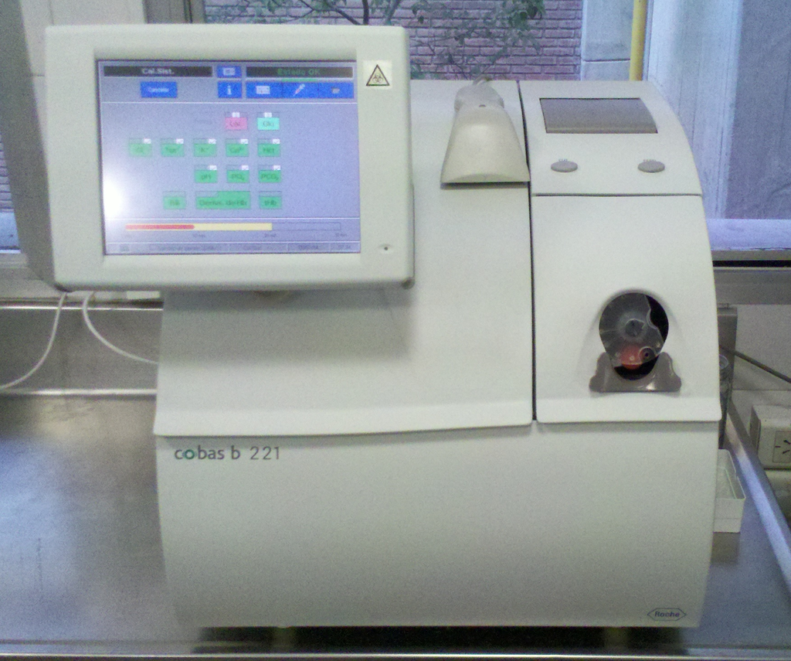
Blood gas/pH analyzers
There are plastic and glass syringes used for blood gas samples. Most syringes come pre-packaged and contain a small amount of heparin, to prevent coagulation.
Once the sample is obtained, care is taken to eliminate visible gas bubbles, as these bubbles can dissolve into the sample and cause inaccurate results.
The sealed syringe is taken to a blood gas analyzer.
If a plastic blood gas syringe is used, the sample should be transported and kept at room temperature and analyzed within 30 min. If prolonged time delays are expected (i.e., greater than 30 min) prior to analysis, the sample should be drawn in a glass syringe and immediately placed on ice.
©
Bio-Chemistry equipment
dr. Chris R. Mol, BME, NORTEC, 2016

Slide 19
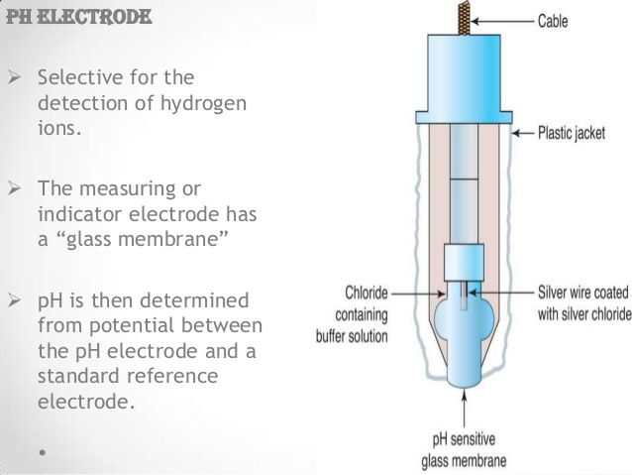
Blood gas/pH analyzers
Blood is collected from the patient and introduced into the analyser. The analyser aspirates the blood into a measuring chamber which has Ion Selective Electrodes that are sensitive only to the measurement of interest
  The pH electrode compares an electric potential developed at the electrode tip with a reference potential, the resulting voltage is proportional to the concentration of hydrogen ions, [H+].
  The pCO2 electrode is a pH electrode with a silicone rubber CO2 semi permeable membrane covering the tip.
  The pO2 electrode features a polypropylene membrane and reacts chemically with a phosphate buffer.
After measurement, the blood is automatically expelled into a waste container and the sample path is cleaned, ready for the next sample. Results may be printed, displayed and sent to the Laboratory Information System.
©
Bio-Chemistry equipment
dr. Chris R. Mol, BME, NORTEC, 2016

Slide 20

END
The creation of this presentation was supported by a grant from THET:
see https://www.thet.org/

